Slide 1
Introduction

Slide 2
What is AI?
What is Artificial Intelligence?
What are the Application Areas of AI?
A (Short) History of AI?
What is this course about?

Slide 3
What is AI?
The definition of AI has been evolving with the advancements in technology
Artificial Intelligence is the theory and development of computer systems able to perform tasks normally requiring human intelligence, such as visual perception, speech recognition, decision-making, and translation between languages

Slide 4
What are the application Areas of AI?
# | Area/Field/Things | # | Area/Field/Things
1 | Virtual Assistant or Chatbots | 7 | Manufacturing and Production
2 | Agriculture and Farming | 8 | Livestock and Inventory Management
3 | Autonomous Flying | 9 | Self-driving Cars or Autonomous Vehicles
4 | Retail, Shopping and Fashion | 10 | Healthcare and Medical Imaging Analysis
5 | Security and Surveillance | 11 | Warehousing and Logistic Supply Chain
6 | Sports Analytics and Activities
Any area where reasoning is to be performed by a machine

Slide 5

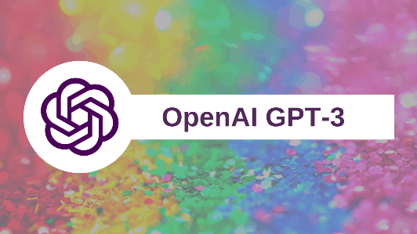
Natural Language
Speech technologies (e.g. Siri)
Automatic speech recognition (ASR)
Text-to-speech synthesis (TTS)
Language processing technologies
Question answering
Machine translation
Web search
Text classification, spam filtering, etc…
General Purposed Language Model?
GPT-3 by OpenAI: better funny stories here https://www.gwern.net/GPT-3
Jukebox by OpenAI: interesting music here https://openai.com/blog/jukebox/

Slide 6
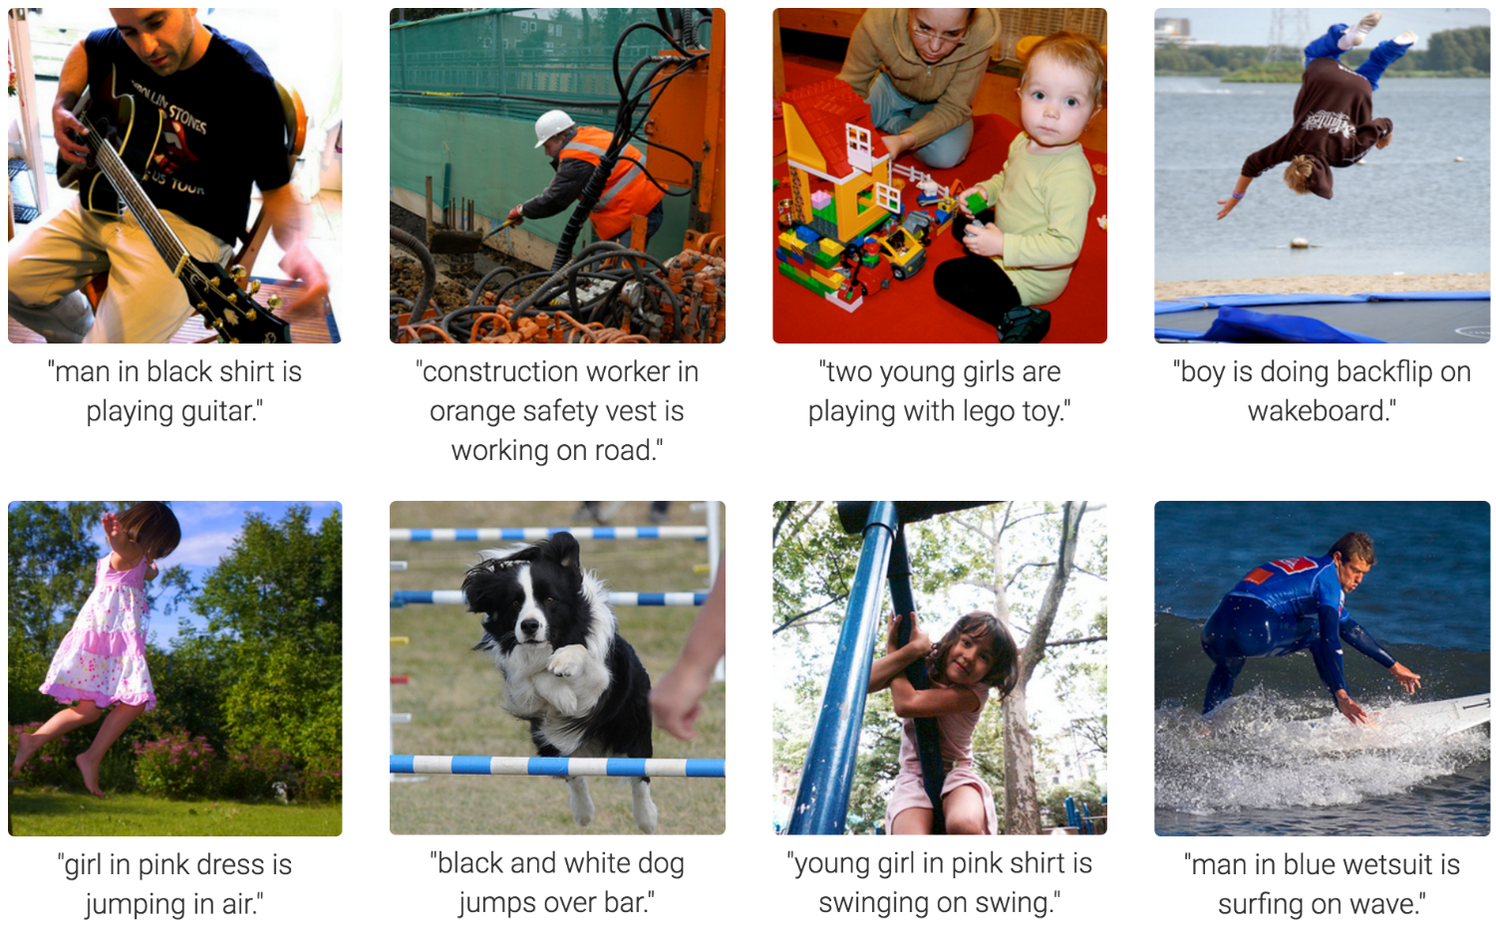
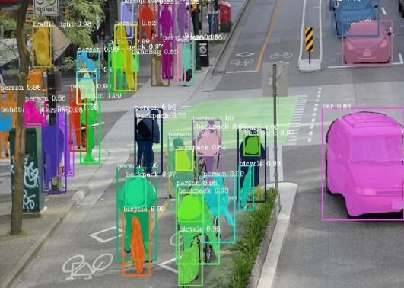

Computer Vision
Image
Captioning
Image Segmentation
Facial Recognition (security)
Notes:
Very Impressive:
Form of prediction and decision.

Slide 7
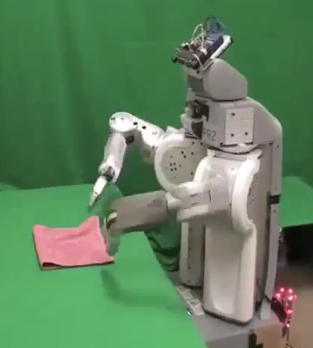
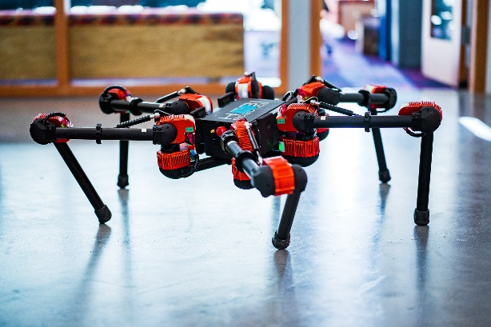
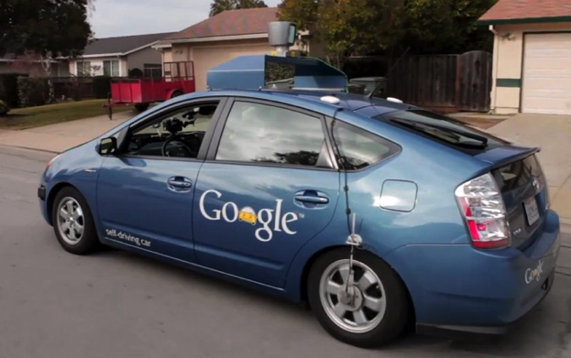
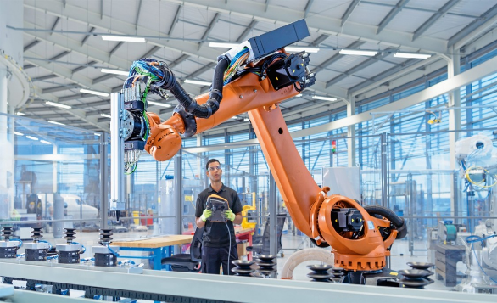
Robotics
Robotics
Part Mech. Eng. and Part AI
Reality much
harder than
simulations!
Technologies
Self-driving cars
Rescue
Help in the home
Lots of automation…

Slide 8

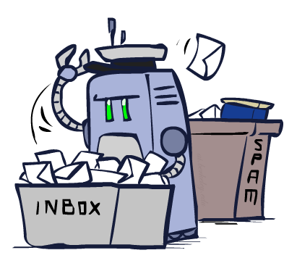
Decision Making
Applied AI involves many kinds of automation
Scheduling, e.g. airline routing, military
Route planning, e.g. Google maps
Medical diagnosis
Web search engines
Automated help desks
Fraud detection
Product recommendations
… Lots more!
This slide was created by Dan Klein and Pieter Abbeel for CS188 Intro to AI at UC Berkeley
Notes:
All applications can be thought of as decision making or useful sub-components of decision making

Slide 9
A (Short) History of AI
Event in History​ | Time Period ​
Alan Turing Wrote the Turing Test​ | 1950s​
Marvin Minsky: Steps towards Artificial Intelligence​ | 1960s​​
Symbolic Integration by James Slagle​
Expert and Ruled based systems​ | 1970s​
Deep Blue Systems (AI) beats world champion of chess​ | 1980s-1990s​
Robotics, Computer Vision, Natural Language Processing, Deep Learning ... etc.​ | 2000-now​

Slide 10
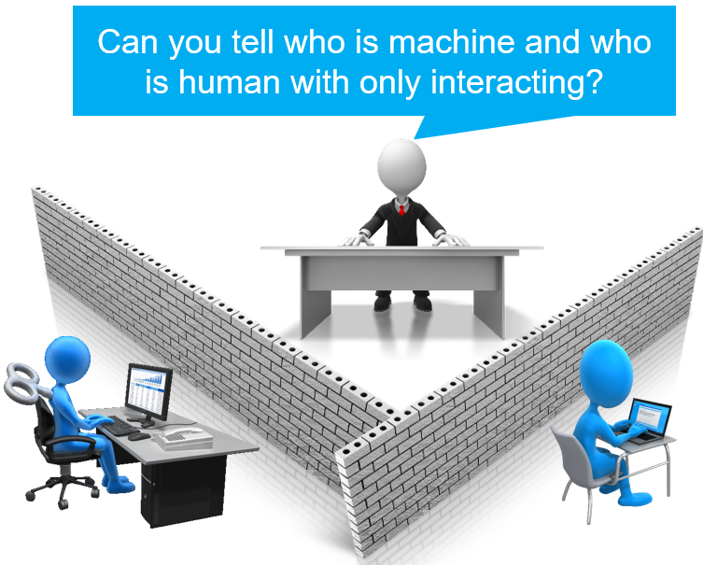
Acting like a Human – Turing Test
Laid the foundation of a method in artificial intelligence (AI) to determining whether a computer is capable of thinking like a human being
What is the Turing Test:
If you don't know who is on the other side, Can you tell the machine from a human by interacting only?
Alan Turing
Notes:
A Turing Test is a method of inquiry in artificial intelligence (AI) for determining whether or not a computer is capable of thinking like a human being. The test is named after Alan Turing, the founder of the Turing Test and an English computer scientist, cryptanalyst, mathematician and theoretical biologist.
Turing proposed that a computer can be said to possess artificial intelligence if it can mimic human responses under specific conditions. The original Turing Test requires three terminals, each of which is physically separated from the other two. One terminal is operated by a computer, while the other two are operated by humans.
During the test, one of the humans functions as the questioner, while the second human and the computer function as respondents. The questioner interrogates the respondents within a specific subject area, using a specified format and context. After a preset length of time or number of questions, the questioner is then asked to decide which respondent was human and which was a computer.
The test is repeated many times. If the questioner makes the correct determination in half of the test runs or less, the computer is considered to have artificial intelligence because the questioner regards it as "just as human" as the human respondent. Source: https://searchenterpriseai.techtarget.com/definition/Turing-test

Slide 11
ELIZA Chatbot
In 1966, Prof. Weizenbaum at MIT developed the program ELIZA, which aimed at tricking its users by making them believe that they were having a conversation with a real human being.
ELIZA was designed to imitate a therapist who would ask open-ended questions and even respond with follow-ups.
Try it out: http://psych.fullerton.edu/mbirnbaum/psych101/eliza.htm

Slide 12
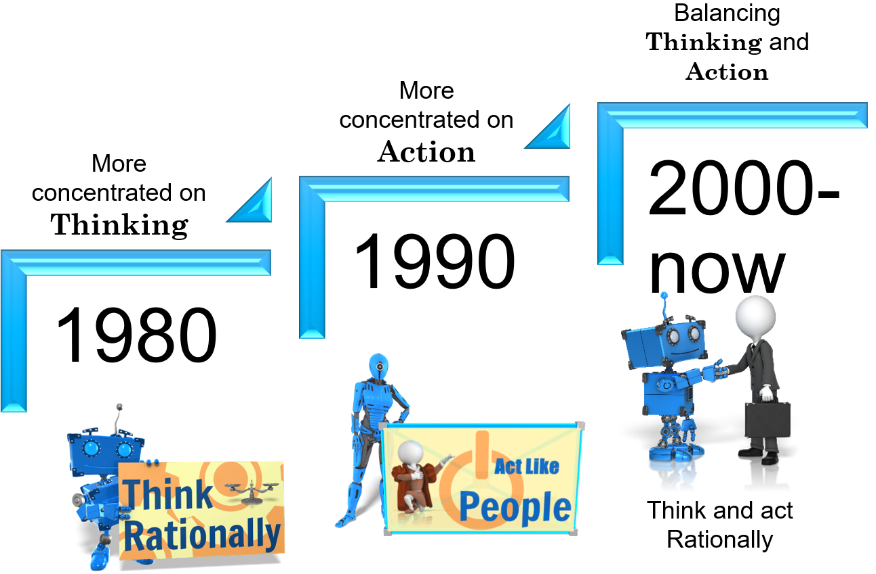
How AI was viewed over time
Notes:
in the 1980 AI was viewed by experts as thinking rationally. The prime objective was to build system that can think. This lead to the innovation of intelligent system where the result will be close to the human thinking process. Examples are the symbolic integration and expert and ruled based system where the process of thinking of human beings were modeled and system were targeted to copy such models. Then in the 1990 the attention shifted in enabling to act like human since few systems were already mature enough to think on their own. Then finally, the year of 2000 started with making AI system that are capable of both acting and thinking. The integration of thinking and acting results in system that given the Turing test are better since it takes a human longer to recognize that they are actually talking to a machine.

Slide 13
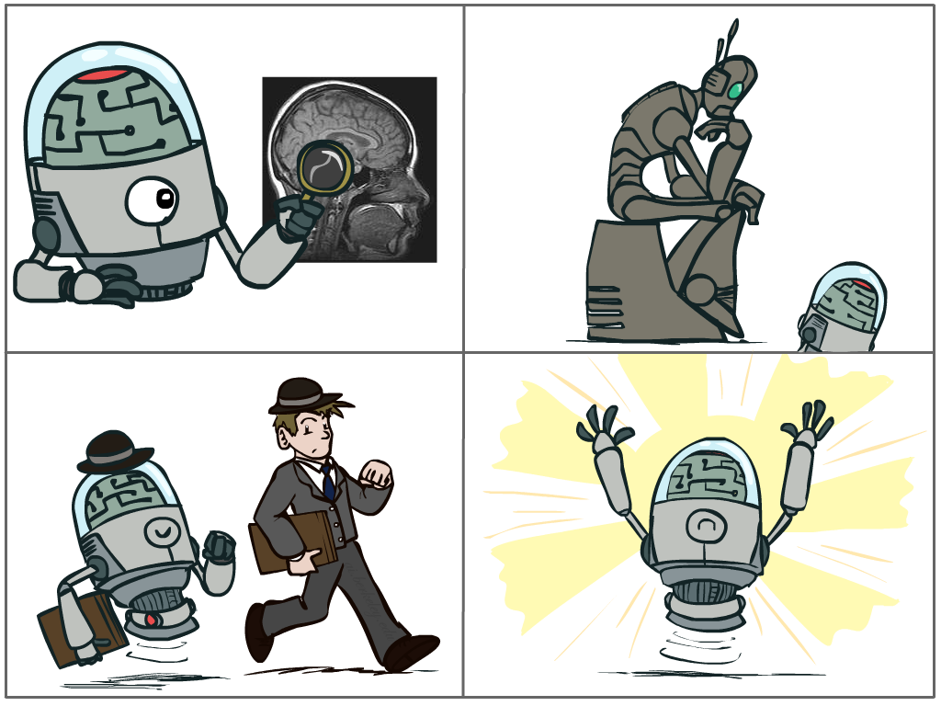
What is AI?
The science of making machines that:
Think like people
Think rationally
Act like people
Act rationally
This slide was created by Dan Klein and Pieter Abbeel for CS188 Intro to AI at UC Berkeley
Notes:
Top left: Think like people --- cognitive science, neuroscience
Bottom left: act like people --- actually very early definition, dating back to Alan Turing --- Turing test; problem to do really well you start focusing on things like don’t answer too quickly what the square root of 1412 is, don’t spell too well, and make sure you have a favorite movie etc. So it wasn’t really leading us to build intelligence
Think rationally – long tradition dating back to Aristotle --- but not a winner, because difficult to encode how to think, and in the end it’s not about how you think, it’s about how you end up acting

Slide 14
Definitions
Agent: A thing that takes inputs using sensors and acts based on these inputs.
Utility in AI : Preferred Outcome or Result. In other words, the mathematical treatment of “preferred outcomes” is called utility.
Example: An agent's preferences over possible outcomes can be captured by numbers; the higher the number the more that agent likes that outcome.

Slide 15
Definitions
Rational: Maximally achieve the best Utility
Rationality is nothing but status of being reasonable, sensible, and having good sense of judgment.
Rationality is concerned with expected actions and results depending upon what the agent has perceived.
Performing actions with the aim of obtaining useful information is an important part of rationality.

Slide 16
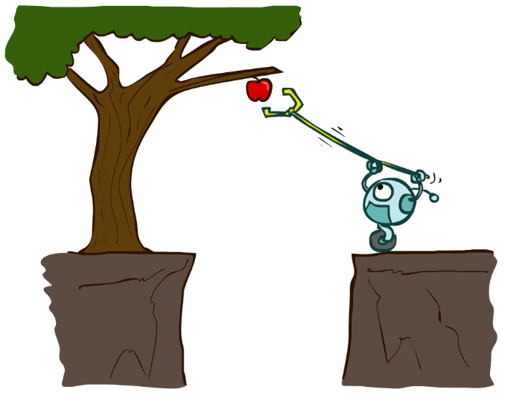
Definitions
Rational Agent: is one that acts to achieve the best outcome or, when there is uncertainty, the best expected outcome.
A rational agent often has clear preference, models uncertainty, and acts in a way to maximize its Utility (performance) with all possible actions.

Slide 17
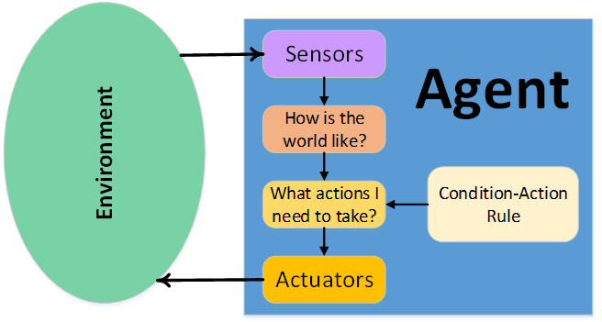
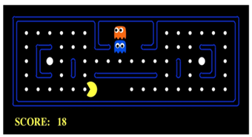
Designing Rational Agents
An agent is an entity that perceives and acts.
A rational agent selects actions that maximize its (expected) utility.
Characteristics of the percepts, environment, and action space dictate techniques for selecting rational actions

Slide 18
Human Brains
Very good in making rational decisions but not perfect
How brain works is still not understood completely
Difficulty in copying its behavior to a machine
How brain works?
Has a huge amount of data (lessons learned across the life of a human)
Can simulate, compute or predict the outcome based on available data or by inference. I.e., unroll the consequences without trying them

Slide 19
What is this course about
Get introduced to a suite of representations that will help you make programs that are intelligent
Use the representations to model a problem and produce useful solutions or predictions

Slide 20
You will learn
Constructing Algorithms (or methods, or procedures) by
exposing the constraints of the problem and
using a representation that supports making of models which facilitate understanding of:
Thinking
Perception
Action

Slide 21
Example1: Use of Perception to solve problems
Problem: A person has one pet lion, one lamb and a bundle of grass. He wants to cross a river but there is only one boat and it can't sustain the weight of more than two articles at time. Also, he has to make sure that the lion doesn't eat the lamb and the lamb doesn't eat the grass. The questions we want to answer are:
How will he get to the other side of the river with all three living beings intact?..
How will you tell (or program) a computer to solve this problem? (the bigger question)
How many possible ways are there to solve such a problem?

Slide 22
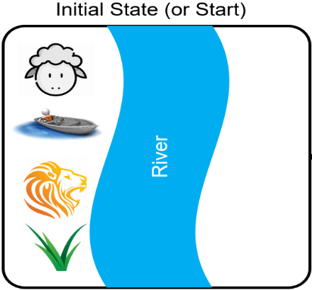
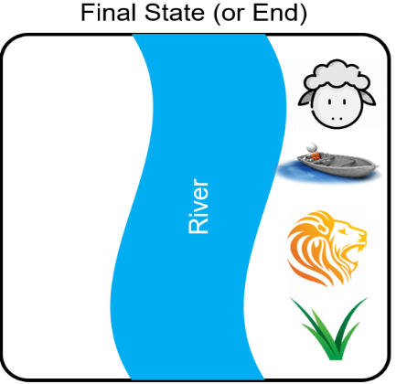
Example1: Use of Perception to solve problems
First, we must understand the problem
Using the right perception will aid our understanding
What is the best representation for the problem?
Visual perception: drawing the situation so we use our visual capabilities

Slide 23
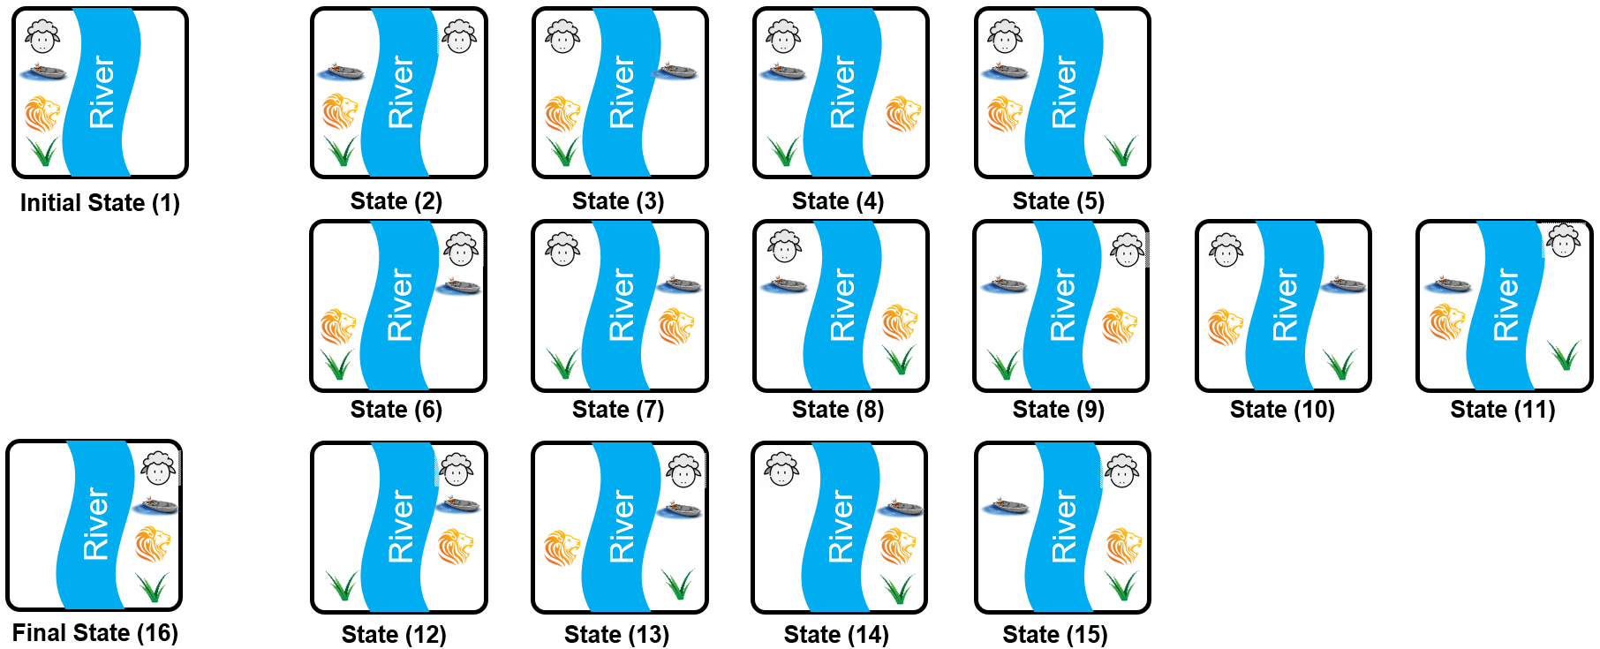
Example1: Use of Perception to solve problems
How many more States (or situation) can there be?
List of all states is shown below:

Slide 24
Example 1: Use of Perception to solve problems
Expose constraints
Lion will eat sheep → state not allowed ()
Sheep will eat grass → state not allowed ()
We now detect those states in which we find someone eating someone else and delete them

Slide 25
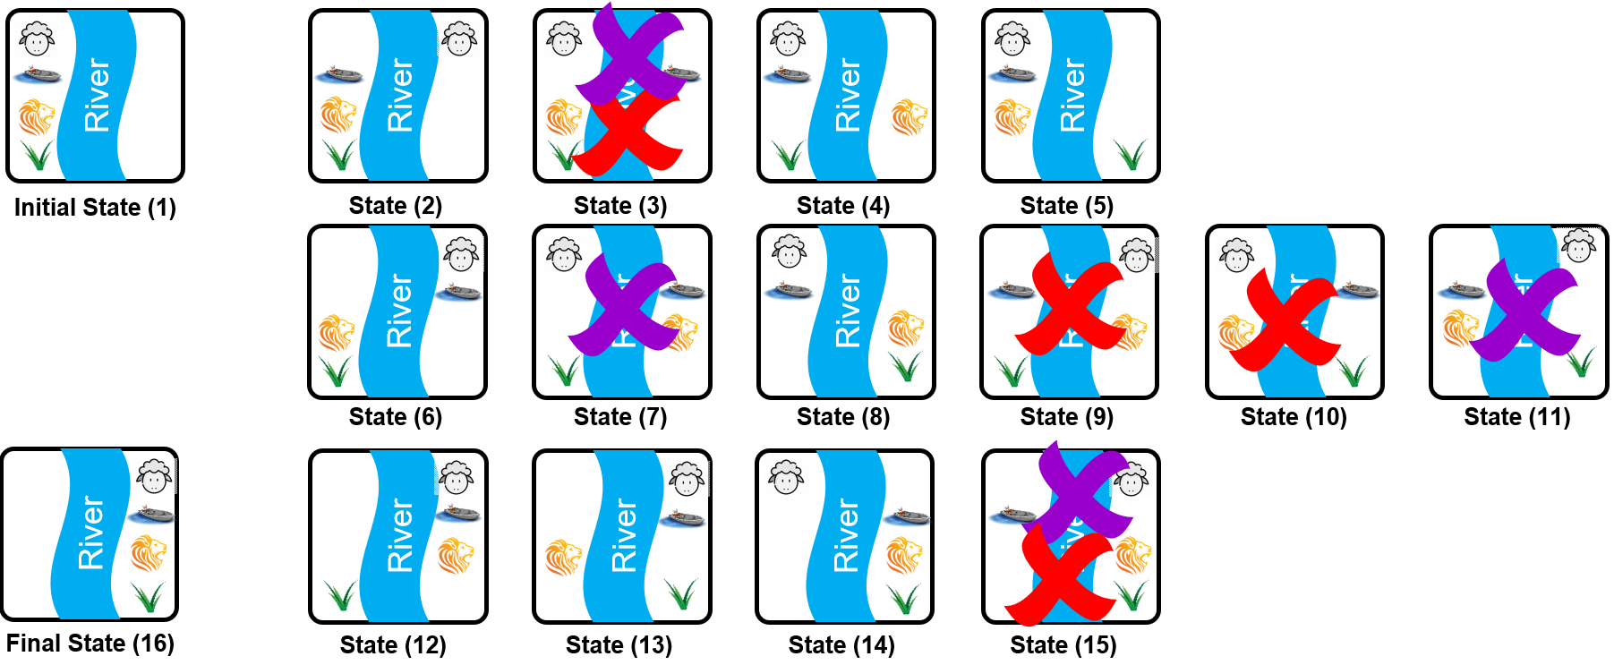
Example 1: Use of Perception to solve problems
Identify the states that violate constraints

Slide 26
Example 1: Use of Perception to solve problems
Removing the states with anomaly will yield

Slide 27
Example 1: Use of Perception to solve problems
Add the final constraints
From one state to another, only one OR no item can accompany the person
Reorder states to go from initial to final states with the above constraint
Apply Reordering Algorithm
Make your state equal to the initial State
Repeat until you reach to the final state:
If you are on the left side of the river, then
Next state = State with single item moved with you to the other side
Else
Next state = State with you moving to the other side with or without item
End If
End Repeat

Slide 28
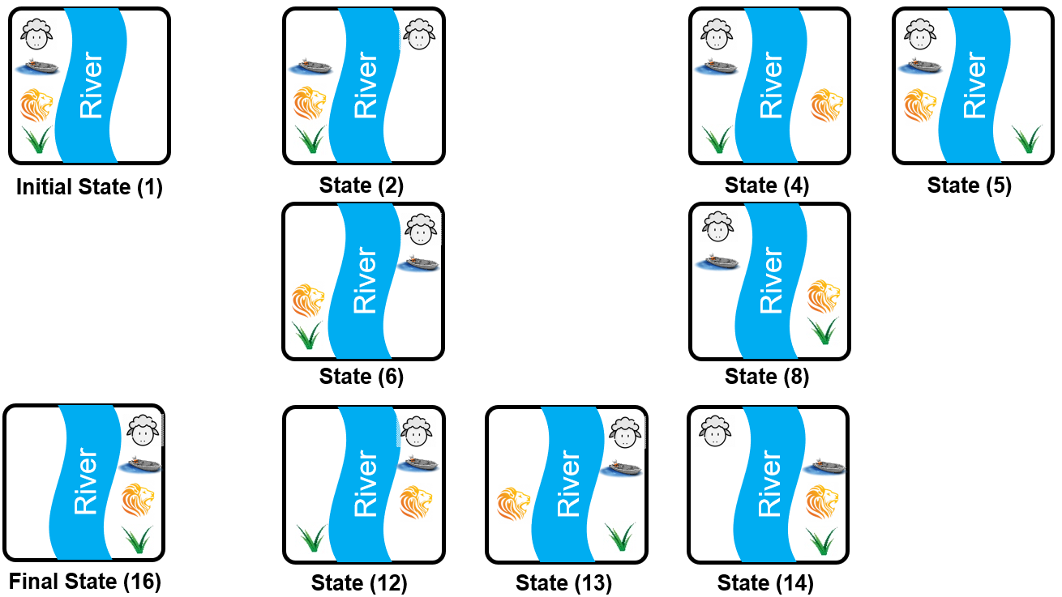
Example 1: Use of Perception to solve problems
Make your state equal to the initial State
Repeat until you reach to the final state:
If you are on the left side of the river, then
Next state = State with single item moved with you to the other side
Else
Next state = State with you moving to the other side with or without item
End If
End Repeat
Available States
Solution

Slide 29
Example 1: Use of Perception to solve problems
Make your state equal to the initial State
Repeat until you reach to the final state:
If you are on the left side of the river, then
Next state = State with single item moved with you to the other side
Else
Next state = State with you moving to the other side with or without item
End If
End Repeat
Available State
Solution

Slide 30
Example 1: Use of Perception to solve problems
Make your state equal to the initial State
Repeat until you reach to the final state:
If you are on the left side of the river, then
Next state = State with single item moved with you to the other side
Else
Next state = State with you moving to the other side with or without item
End If
End Repeat
Available State
Solution

Slide 31
Example 1: Use of Perception to solve problems
Make your state equal to the initial State
Repeat until you reach to the final state:
If you are on the left side of the river, then
Next state = State with single item moved with you to the other side
Else
Next state = State with you moving to the other side with or without item
End If
End Repeat
Available State
Solution

Slide 32
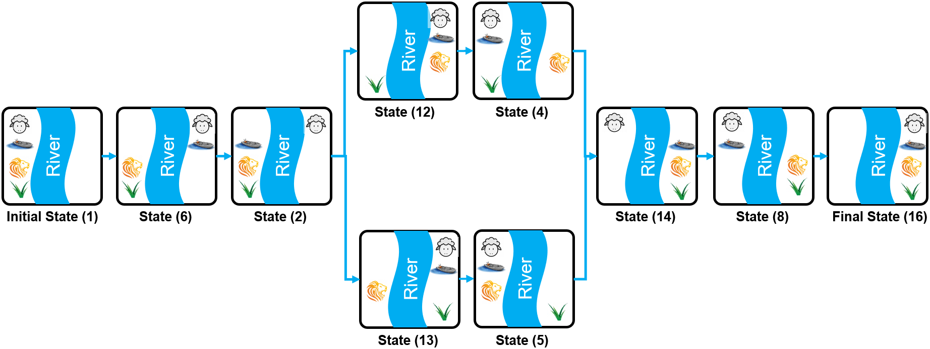
Example 1: Use of Perception to solve problems
Result

Slide 33
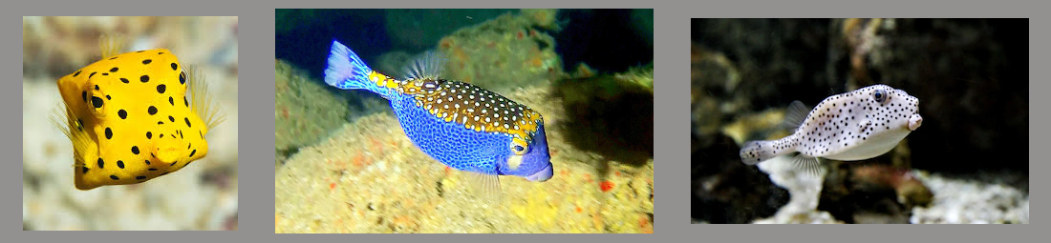
Example 2: Generate and Test in AI
Problem: What is the name of the fish shown?
Before thinking of AI and if you don’t already know it, what would you do?

Slide 34

Example 2: Generate and Test in AI
Go online and search for the fish by flipping web pages until it is found
Try to find a match by extracting some features (shape, size, color … etc.) and matching it with pictures of the fish on the web
This step is a form of feature extraction
Good features are often discriminating features and are unique about the object under consideration.

Slide 35

Example 2: Generate and Test in AI
Examples of Good features (for the fish under investigation):
Has a square head (since not many fish have square shaped head)
Comes in different colors and has patterns on its body,
Mouth is pointing downwards (many fish don't have pointy mouth)
Eyes on the side of the square head (eyes are close to the head edge) … etc.

Slide 36

Example 2: Generate and Test in AI
Examples of Bad features (for the fish under investigation):
lives in water or sea (all fish live in water or sea, so this feature does not add any value)
swims close to rocks (features should give unique information about the object that help in identifying fish, again this is something common to all fish)
lives only in lighted area (to take good pictures we need to have a light but that does not mean that this fish cannot live in the dark)

Slide 37
Example 2: Generate and Test in AI
Generally, Good features
should take you closer to the target, while bad features do not add any value
should help us or the computer to identify unique things about the fish. Since one feature may not be enough to identify the fish, the goal is to have the minimum number of features to uniquely identify the fish.

Slide 38
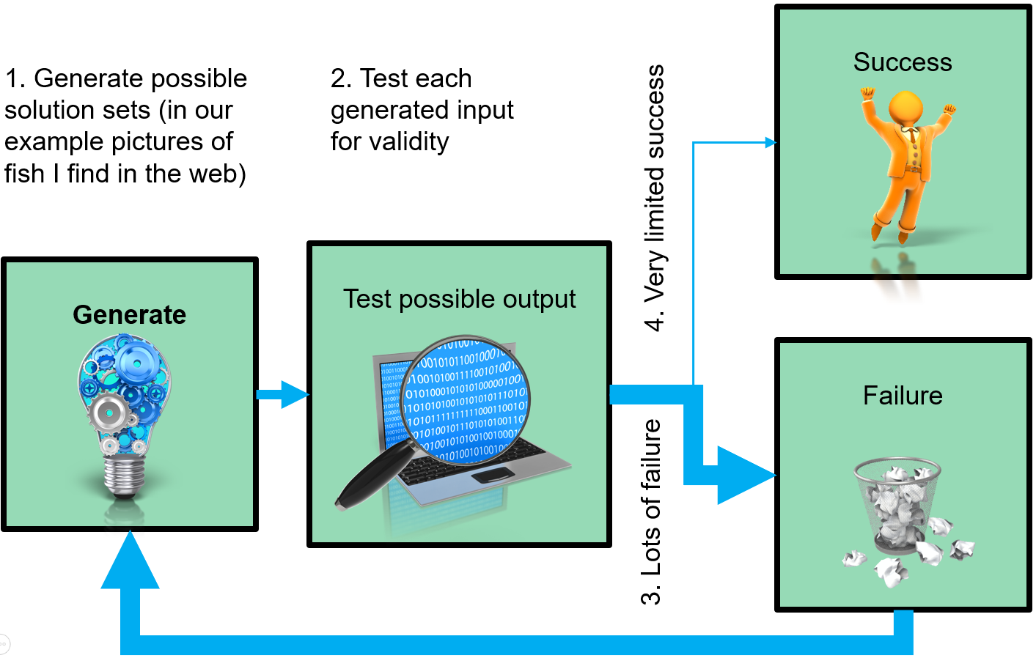
Example 2: Generate and Test in AI
Procedure

Slide 39
Generate and Test Properties
A generator must have good properties:
Should not be redundant: i.e., should not generate the same case more than once.
In the example of the fish, we don't want to test the same fish more than once.
Should be informable: supply knowledge related to the matter or subject in hand.
In the fish example, we don't want the generator to produce pictures of dogs, cats, planes or cars
Extract meaningful test features to determine success vs failure
Test should be fast and efficient

Slide 40
Summary
We introduced the subject of AI
Went over some definitions
Agents in AI
Rationality in AI
Rational Agents
We presented two ways to solve problems
Using representation and constraints to find a solution
Generate and test methodology

